Slide 1

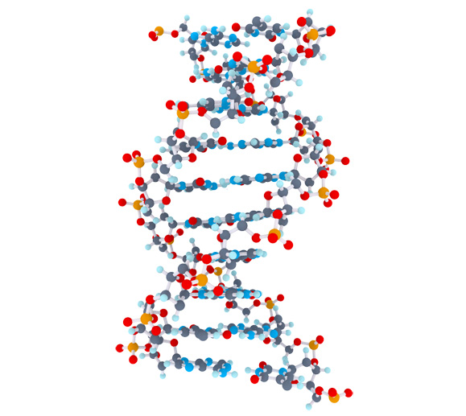
Celiac Disease Triggers
Matthijs Knigge

Slide 2
Overview
Project goal
Mendelian Randomization
Methods
Data
Pipeline
Preliminary results
Future steps

Slide 3
Project Goal
Inspect > 440.000 clinical parameters and molecular mechanisms to;
Identification of factors that cause or protect against Celiac Disease
Quantify the impact of causal or protective factors

Slide 4



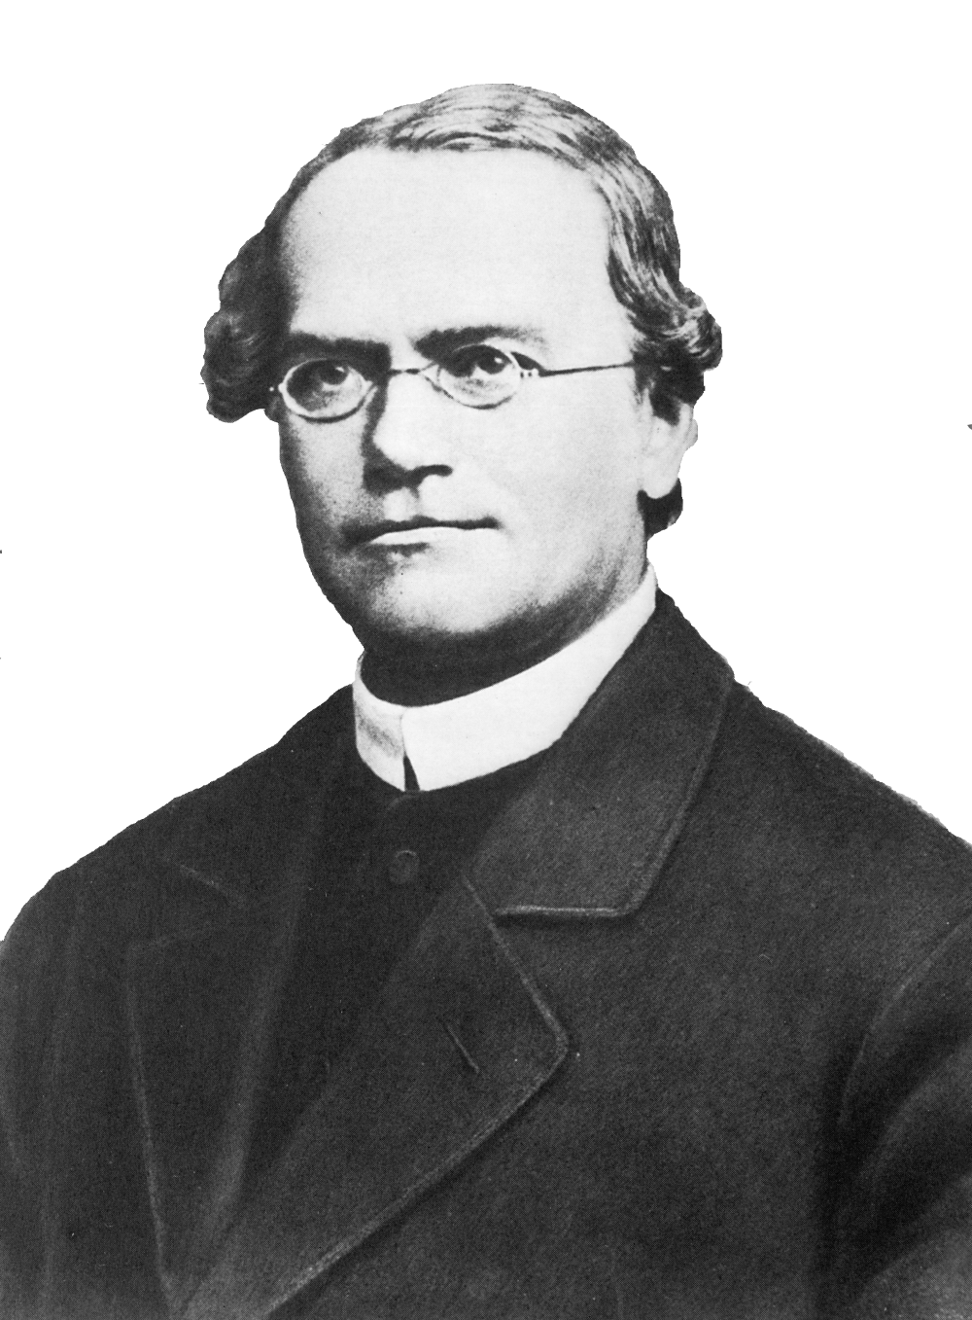










Mendelian Randomization (MR)
Randomized Controlled Trials (RCT)
Sample
Random assignment of subjects
Sample
Random allocation of alleles
Case
Control
Genotype
AA
Genotype
aa
Target effects
Protein effects
Outcome

Slide 5


Mendelian Randomization setup
SNP
Exposure phenotype
Outcome phenotype
Confounders
Rules that need to be met before using a genetic variant in the MR framework
The genetic variant must be associated with the exposure of interest
The genetic variant must not be associated with confounders
The genetic variant may only affect the outcome through the exposure

Slide 6



Methods
Two-Sample MR | - Estimate causal effect between different samples - Summary-level data from GWAS can be used | - Cannot test for confounding - No overall causal estimate - Assumes genetic variants are uncorrelated (not in linkage disequilibrium) | - Causal estimate between genetic variants
Inverse-Variance Weighted method (IVW) | - Overall causal estimate between exposure and outcome - Summary-level data from GWAS can be used | - Assumes causal estimates provide independent evidence (no correlation) - Cannot test for confounding | - Overall causal estimate between exposure and outcome
MR-egger method | - Can be deployed when the core assumptions do not hold. - Can test for confounding (correlation between variants) - Can test for a causal effect - An estimate of the overall causal effect | - Needs 3 or more genetic variants - Assumes genetic variants are uncorrelated - Cannot distinguish between pleiotropy and a causal effect when genetic variants almost have equal estimates | - Overall causal estimate - MR-egger causal test - Overall pleiotropic effect
Bidirectional MR | - Can determine when genetic variant exhibits primary effect on the exposure, or the effect is secondary to the outcome | - difficulty in the presence of genetic variants that influence each other | - MR analysis in both directions, that ascertains direction of causal relationship

Slide 7
Data
 | Type | Amount of Phenotypes | Direction
Celiac, Trynka 2011 | GWAS Immunochip | 1 | Outcome
Celiac, Dubois 2010 | GWAS Immunochip | 1 | Outcome
The NHGRI-EBI GWAS catalog | Publicated GWAS | 2893 | Exposure
MRbase Metabolite | GWAS on metabolites in whole blood | 121 | Exposure
MRbase Proteins | GWAS on protein levels whole blood | 47 | Exposure
MRbase Gene Expression levels (GTEX) | GWAS on gene identifiers in 44 different tissues | 280380 | Exposure
MRbase Methylation levels | GWAS on methylation levels in whole blood across 5 time points | 151566 | Exposure
additional downloaded GWAS | GWAS | 1308 | Exposure
UK.BIOBANK | GWAS | 778 | Exposure
Gene expression | GWAS | 9744 | Exposure
pQTL | GWAS | 198 | Exposure
Total | 447037

Slide 8
Pipeline
SNP | effect_allele | beta | se | p
rs61733845 | T | 0.03536714 | 0.04432255 | 2.465e-06
rs1320571 | A | 0.01882175 | 0.04265126 | 6.590e-01
.... | .... | …. | …. | ….
GWAS
Celiac 2011. Gosia Trynka et al.
SNP | effect_allele | beta | se | p
rs314253 | C | -0.0201900 | 0.002646 | 2.471e-14
rs7775397 | G | -0.0369352 | 0.004845 | 2.721e-14
.... | …. | …. | …. | ….
GWAS
HDL, LDL, Triglycerides. Willer CJ et al. Discovery and refinement of loci associated with lipid levels. Nat. Genet. 2013. doi:10.1038/ng.2797
Outcome = Celiac Disease, Exposure = HDL, LDL, Triglycerides

Slide 9
Pipeline
Data input
Operation
GWAS exposure
Select genome-wide significance on exposure
First core assumption
Remove variants without Beta/Log odds on exposure
1000 Genomes
Query missing alleles by reference on exposure
GWAS outcome
Find overlap between exposure and outcome
Harmonize Outcome on Exposure
HLA region removed
- Positive align exposure
- Align outcome on exposure
- Remove palindromic SNPs

Slide 10


Data input
Operation
GWAS exposure
GWAS outcome
Clumping for proxy SNPs with PLINK
Second core assumption
Perform Wald-method
Perform Inverse-Variance Weighted method
Perform MR-egger method
Perform Cochran's Q test
Third core assumption
Perform Bidirectional MR
- Outcome becomes exposure
- Exposure becomes outcome
https://bitbucket.org/MatthijsKnigge/mendelianrandomization.git

Slide 11
Preliminary results
Before FDR correction
Category | Celiac 2011 ~ Exposure | Celiac 2010 ~ Exposure | Exposure ~ Celiac 2011, * | Exposure ~ Celiac 2010, *
Clinical Phenotype | 1388 | 889 | 1990 | 1982
Metabolites | 76 | 1 | 0 | 0
Proteins | 3 | 3 | 1 | 1
Gene Expression | 3461 | 4992 | 65 | 45
Methylation | 3750 | 0 | 0 | 0
After FDR correction
Category | Celiac 2011 ~ Exposure | Celiac 2010 ~ Exposure | Exposure ~ Celiac 2011, * | Exposure ~ Celiac 2010, *
Clinical Phenotype | 166 | 32 | 208 | 145
Metabolites | 0 | 0 | 0 | 0
Proteins | 0 | 0 | 0 | 0
Gene Expression | 25 | 14 | 1 | 0
Methylation | 0 | 0 | 0 | 0
* MRbase not analysed in reverse yet

Slide 12
Preliminary results, Forward
Celiac 2011, Gosia Trynka et al. ~ Exposure
185 significant potential exposures
Top 10
Exposure | IVW | Egger | nSNP
Type 1 Diabetis Meta Analysis | 1.589504e-24 | 7.291180e-01 | 56
Type 1 Diabetis | 2.052863e-20 | 7.348035e-01 | 50
Inflammatory Bowel Disease | 8.241646e-12 | 6.301454e-01 | 59
Ulcerative colitis | 1.149234e-10 | 7.566844e-02 | 36
Crohns disease | 1.791261e-10 | 7.408463e-01 | 48
plateletcrit | 3.435332e-10 | 7.110506e-08 | 67
IL18RAP (gene expression) | 9.457623e-10 | 9.280580e-01 | 9
platelet count | 2.839670e-09 | 7.039575e-06 | 77
Packed cell volume | 4.735074e-09 | 3.384431e-01 | 5
Primary biliary cirrhosis | 7.208134e-09 | 9.521848e-01 | 27

Slide 13
Preliminary results, Reverse
Exposure ~ Celiac 2011, Gosia Trynka et al.
209 significant potential exposures
Top 10
Exposure | IVW | Egger | nSNP
Platelet crit | 3.575738e-66 | 5.761514e-07 | 48
thyroid problem (not cancer) | 8.414018e-60 | 3.193874e-01 | 48
Platelet count | 2.033008e-51 | 4.996859e-01 | 48
Type 1 Diabetis Meta Analysis | 7.136551e-50 | 6.925841e-01 | 48
Type 1 Diabetis | 2.826052e-45 | 8.576514e-01 | 48
Eosinophill count | 5.173730e-38 | 9.888424e-01 | 48
Lymphocyte percentage | 8.730661e-36 | 2.770322e-01 | 48
Inflammatory Bowel Disease | 3.094949e-34 | 5.491841e-01 | 48
E03 Other hypothyroidism | 1.727432e-33 | 5.923195e-01 | 48
Eosinophill percentage | 3.381566e-31 | 9.790395e-01 | 48

Slide 14
Preliminary results, Forward
Celiac 2010, Patrick Dubois et al. ~ Exposure
32 significant potential exposures
Top 10
Exposure | IVW | Egger | nSNP
Type 1 Diabetis Meta Analysis | 4.859082e-22 | 1.487445e-01 | 33
Type 1 Diabetis | 4.249713e-20 | 9.059520e-02 | 26
IL18RAP (gene expression) | 1.339638e-11 | 1.274314e-02 | 9
CMTM7 (gene expression) | 4.408545e-08 | 8.447033e-01 | 7
Inflammatory Bowel Disease | 4.226268e-06 | 8.078122e-01 | 42
Ulcerative colitis | 3.518295e-05 | 2.062526e-01 | 27
Primary biliary cirrhosis | 3.768606e-05 | 9.328913e-01 | 20
Coronary artery disease mi additive | 1.210912e-04 | 7.857370e-01 | 15
Crohns disease | 1.678295e-04 | 8.598359e-01 | 36
Rheumatoid Arthritis | 1.951175e-04 | 3.587785e-01 | 4

Slide 15
Preliminary results, Reverse
Exposure ~ Celiac 2010, Patrick Dubois et al.
145 significant potential exposures
Top 10
Exposure | IVW | Egger | nSNP
K90 Intestinal malabsorption | 5.812490e-63 | 0.3689493413 | 10
Platelet crit | 4.181290e-51 | 0.0001414908 | 10
thyroid problem (not cancer) | 2.466238e-42 | 0.0976389945 | 10
Platelet count | 9.184329e-40 | 0.0001414908 | 10
Eosinophill count | 1.092300e-26 | 0.0004678592 | 10
E03 Other hypothyroidism | 2.466970e-23 | 0.6321703636 | 10
E00-E07 Disorders of thyroid gland | 2.754765e-20 | 0.6321703636 | 10
Eosinophill percentage | 1.102760e-17 | 0.0011727342 | 10
K90-K93 Other diseases of the digestive system | 2.370714e-17 | 0.9673294238 | 10
Inflammatory Bowel Disease | 3.222523e-16 | 0.6983328248 | 10

Slide 16
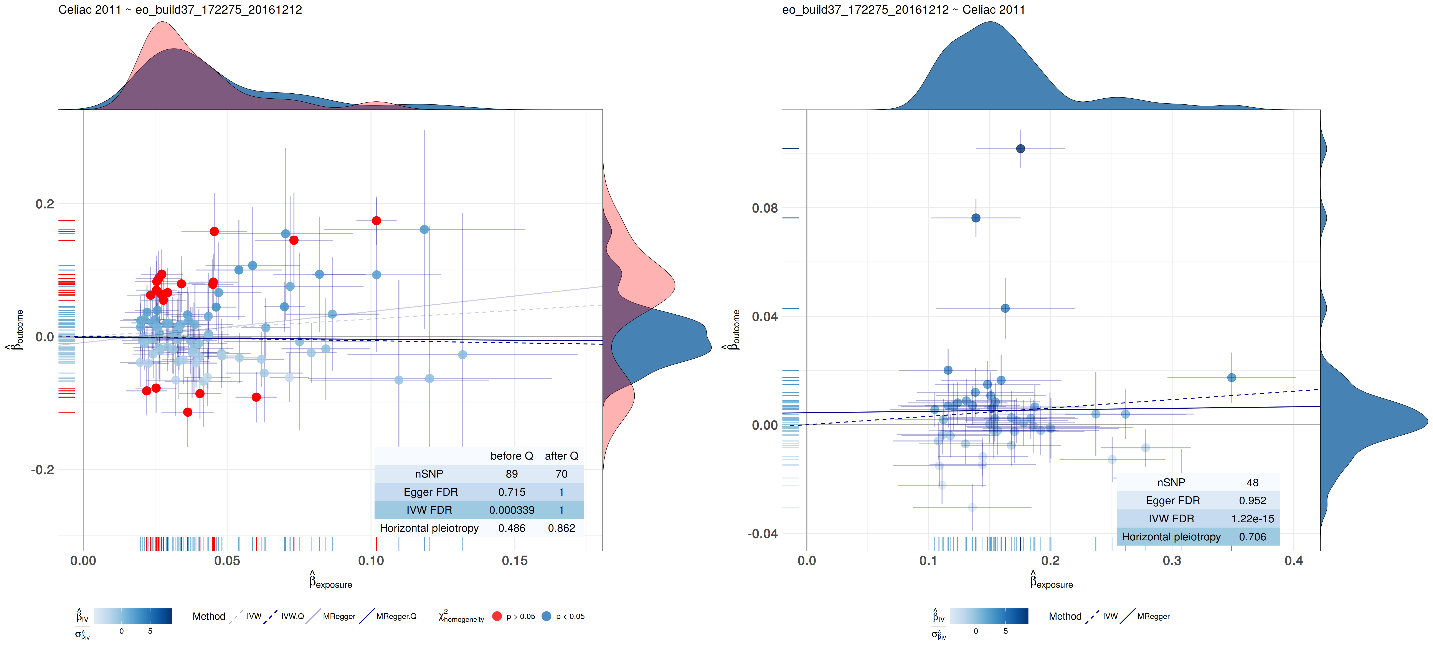
Preliminary results Bidirectional MR
Celiac 2011, Gosia Trynka et al.

Slide 17
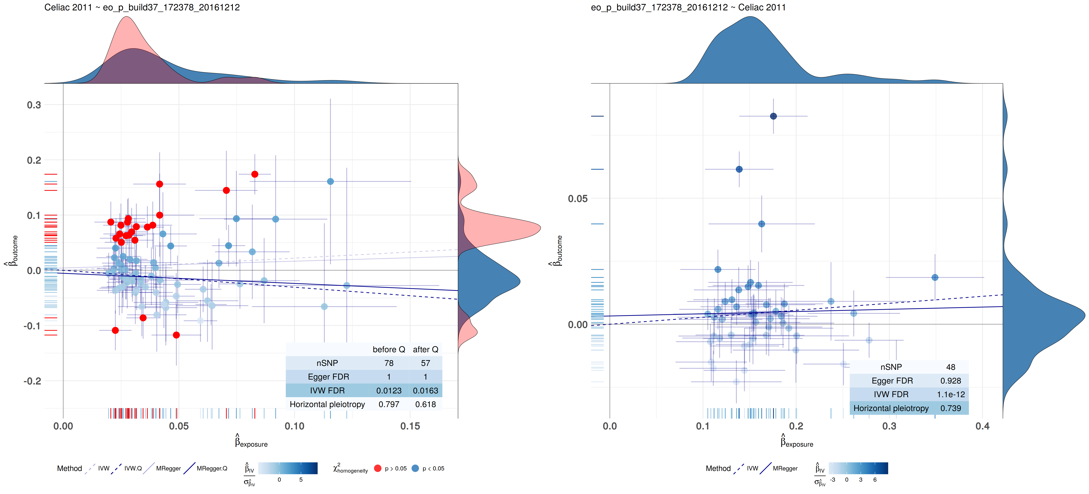
Preliminary results Bidirectional MR
Celiac 2011, Gosia Trynka et al.

Slide 18
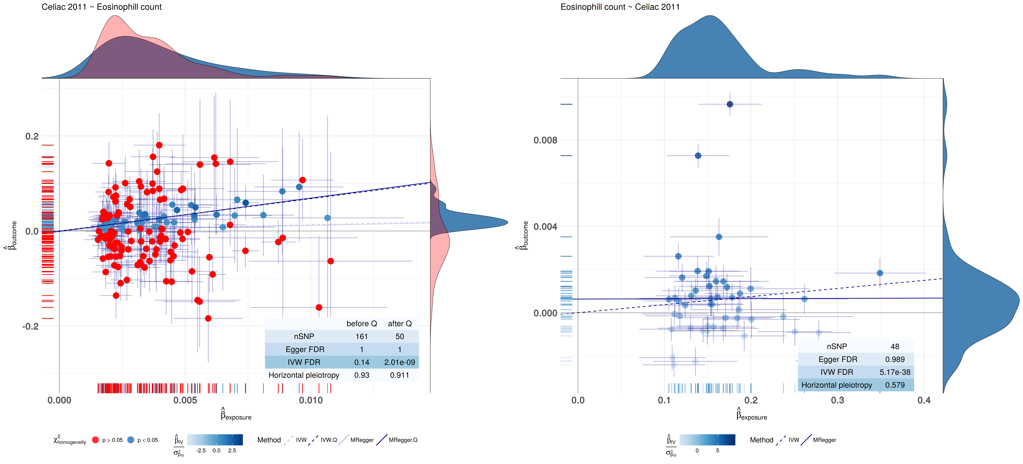
Preliminary results Bidirectional MR
Celiac 2011, Gosia Trynka et al.

Slide 19
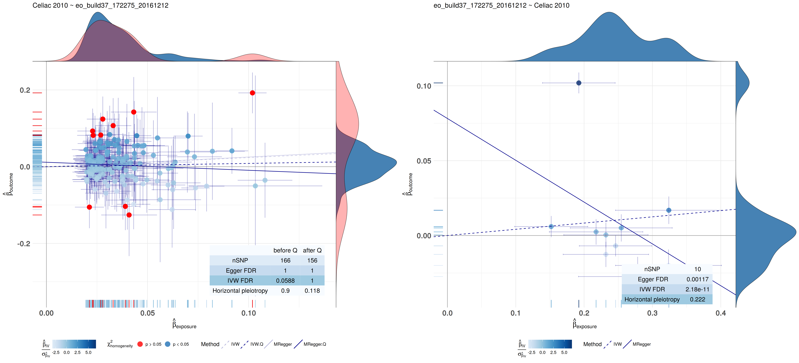
Preliminary results Bidirectional MR
Celiac 2010, Patrick Dubois et al.

Slide 20
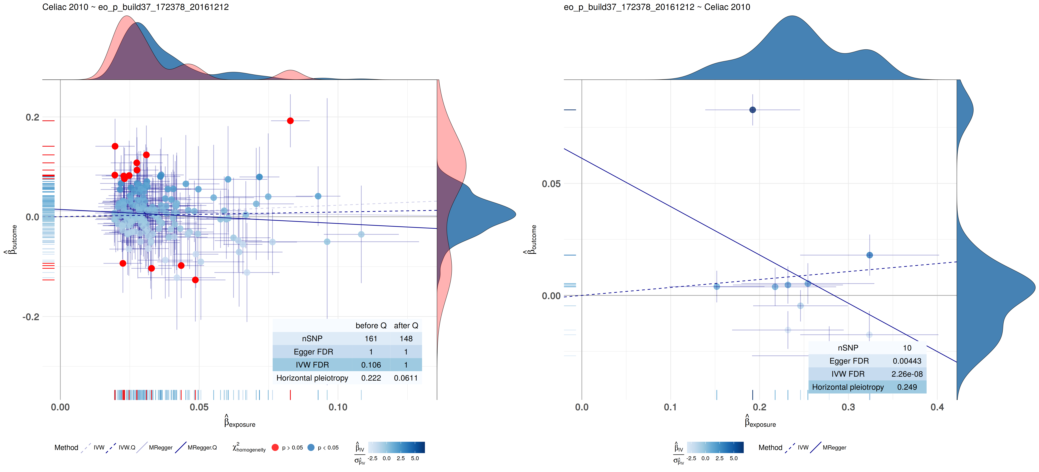
Preliminary results Bidirectional MR
Celiac 2010, Patrick Dubois et al.

Slide 21
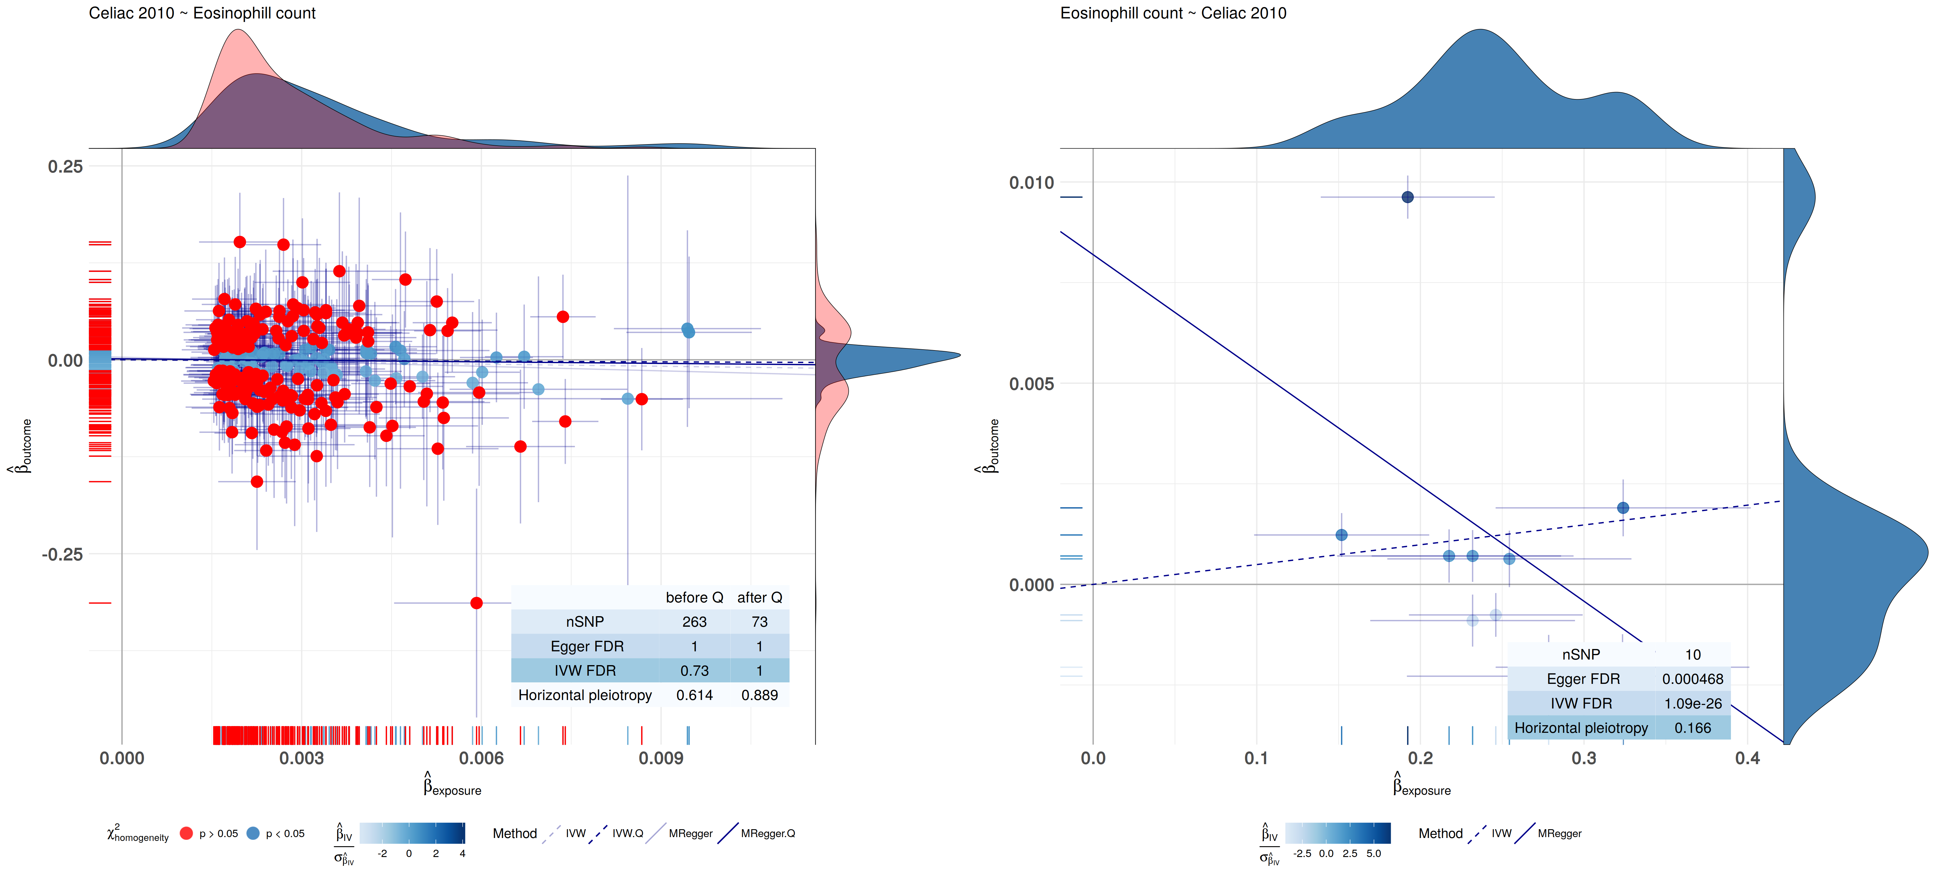
Preliminary results Bidirectional MR
Celiac 2010, Patrick Dubois et al.

Slide 22
Conclusions
Celiac 2011, Gosia Trynka et al. ~ Exposure, Forward
Phenotype | Conslusion
Type 1 Diabetis | Lower risk for Type 1 Diabetis protects for Celiac Disease
Inflammatory Bowel Disease | Lower risk for Inflammatory Bowel Disease protects for Celiac Disease
Ulcerative colitis | Lower risk for Ulcerative colitis protects for Celiac Disease
Crohns disease | Lower risk for Crohns disease protects for Celiac Disease
plateletcrit | Lower level of plateletcrit protects for Celiac Disease
IL18RAP (gene expression) | Higher level of IL18RAP expression protects for Celiac Disease
platelet count | Lower level of platelet count protects for Celiac Disease
Packed cell volume | Lower level of packed cell volume protects for Celiac Disease
Primary biliary cirrhosis | Lower risk for Primary biliary cirrhosis protects for Celiac Disease

Slide 23
Conclusions
Exposure ~ Celiac 2011, Gosia Trynka et al., Reverse
Phenotype | Conslusion
Platelet crit | Lower risk for Celiac Disease protects for higher levels of Platelet crit
thyroid problem (not cancer) | Lower risk for Celiac Disease protects for thyroid problem (not cancer)
Platelet count | Seemingly a higher risk for Celiac Disease protects for higher levels in Platelet count, but this is driver by a subset of SNPs
Type 1 Diabetis | Lower risk for Celiac Disease protects for Type 1 Diabetes
Eosinophill count | Lower risk for Celiac Disease protects for higher Eosinophill count levels
Lymphocyte percentage | Higher risk for Celiac Disease protects for lower Lymphocyte percentage
Inflammatory Bowel Disease | Lower risk for Celiac Disease protects for Inflammatory Bowel Disease
E03 Other hypothyroidism | Lower risk for Celiac Disease protects for Other hypothyroidism
Eosinophill percentage | Lowe risk for Celiac Disease protects for lower Eosinophill percentage

Slide 24
Conclusions
Celiac 2010, Patrick Dubois et al. ~ Exposure, Forward
Phenotype | Conslusion
Type 1 Diabetis | Lower risk for Type 1 diabetis protects for Celiac Disease
IL18RAP (gene expression) | Higher level of IL18RAP expression protects for Celiac Disease
CMTM7 (gene expression) | Higher level of CMTM7 expression protects for Celiac Disease
Inflammatory Bowel Disease | Lower risk for Inflammatory Bowel Disease protects for Celiac Disease
Ulcerative colitis | Lower risk for Ulcerative colitis protects for Celiac Disease
Primary biliary cirrhosis | Lower risk for Primary biliary cirrhosis protects for Celiac Disease
Coronary artery disease mi additive | Lower risk for Coronary artery disease mi additive protects for Celiac Disease
Crohns disease | Lower risk for Crohns disease protects for Celiac Disease
Rheumatoid Arthritis | Lower risk for Rheumatoid Arthritis protects for Celiac Disease

Slide 25
Conclusions
Exposure ~ Celiac 2010, Patrick Dubois et al., Reverse
Phenotype | Conslusion
K90 Intestinal malabsorption | Lower risk for Celiac Disease protects for K90 Intestinal malabsorption
Platelet crit | Lower risk for Celiac Disease protects for higher levels in Platelet crit
thyroid problem (not cancer) | Lower risk for Celiac Disease protects for thyroid problem
Platelet count | Higher risk for Celiac Disease protects for lower levels in Platelet count
Eosinophill count | Lower risk for Celiac Disease protects for higher levels in Eosinophill count
E03 Other hypothyroidism | Lower risk for Celiac Disease protects for Other hypothyroidism
E00-E07 Disorders of thyroid gland | Lower risk for Celiac Disease protects for Disorders of thyroid gland
Eosinophill percentage | Lower risk for Celiac Disease protects for higher levels in Eosinophill percentage
K90-K93 Other diseases of the digestive system | Lower risk for Celiac Disease protects for Other diseases of the digestive system
Inflammatory Bowel Disease | Lower risk for Celiac Disease protects for Inflammatory Bowel Disease

Slide 26
Future steps
Use PreventCD cohort to validate by predicting causal or protective factors identified
Pathway analysis on SNPs in significant hits
Network Mendelian Randomization

Slide 27
Acknowledgements
Serena Sanna
Adriaan van der Graaf

